Slide 1
Gen AI Workshop Testing

Slide 2
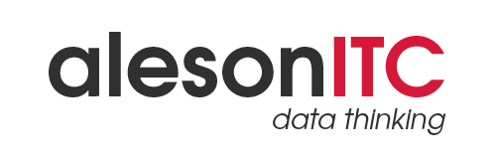

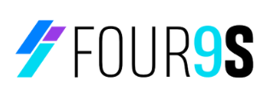
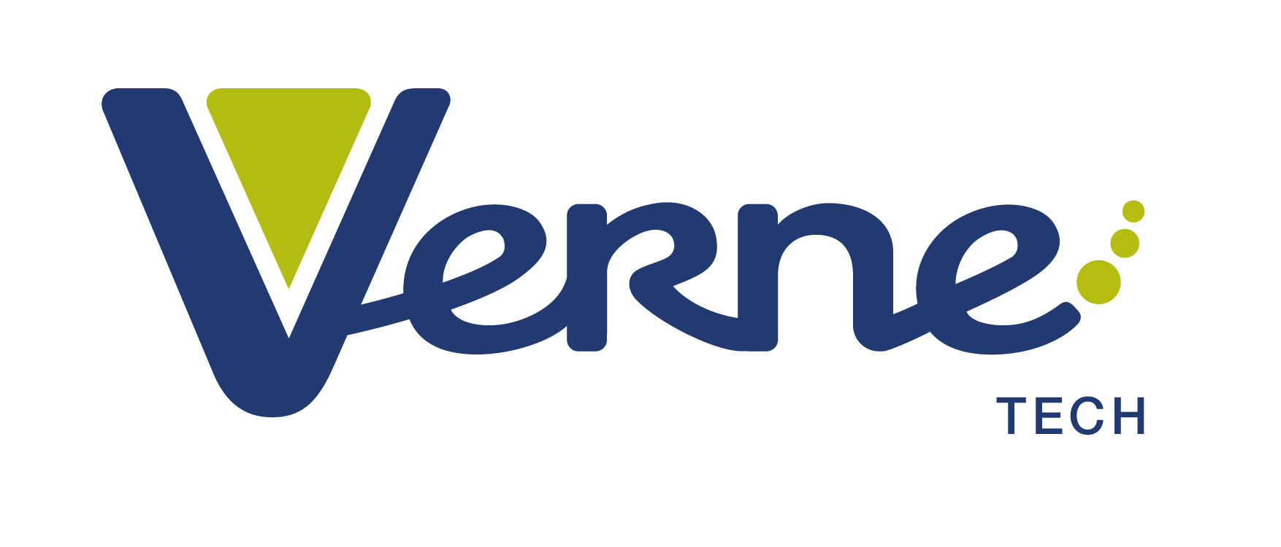
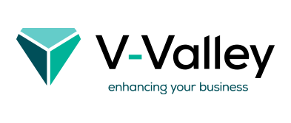
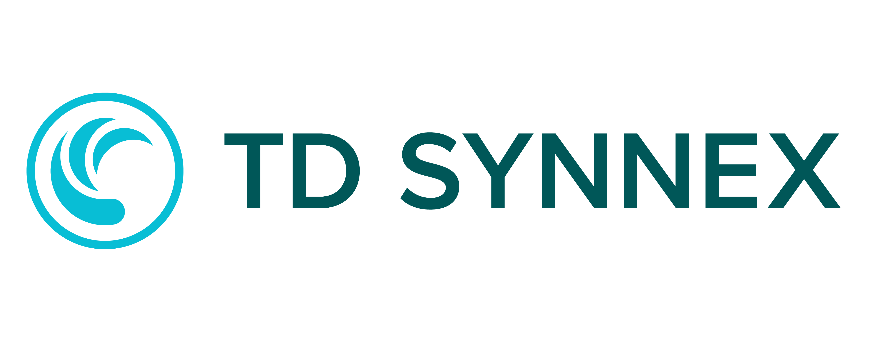
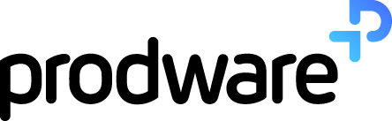
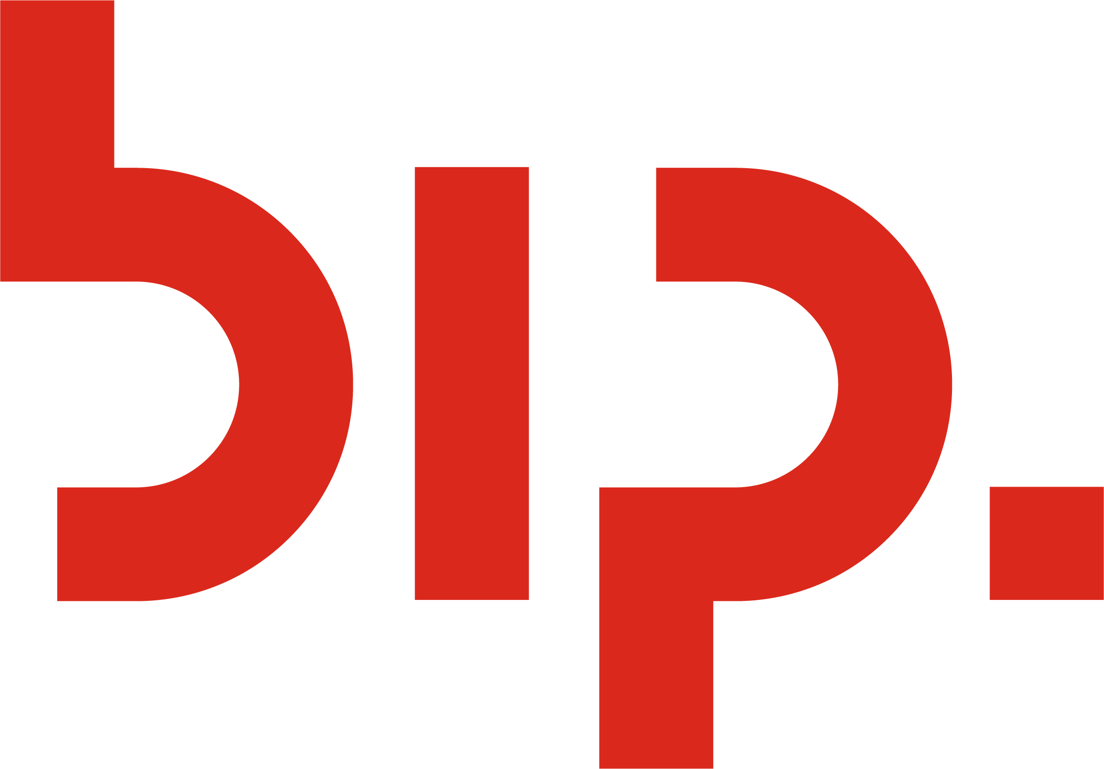
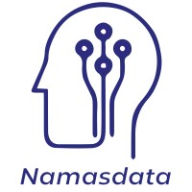
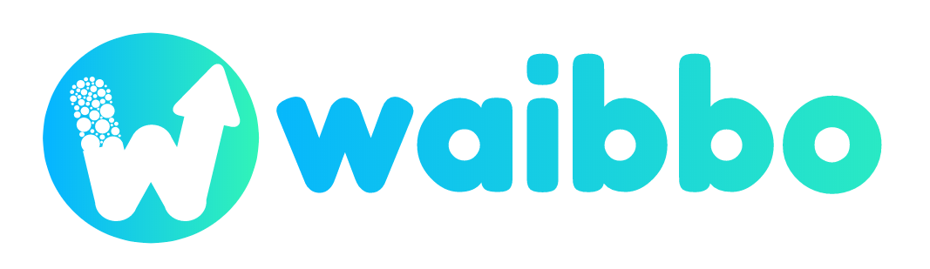
¡Gracias sponsors!
Platinum
Gold
Silver

Slide 3
What slows down Generative AI adoption?
Getting Started | The state of the art is evolving so quickly, it makes it difficult to decide what to use. Along with that, guidance and documentation is hard to find.
Development | Applications often require multiple cutting-edge products and frameworks which requires specialized expertise and new tools to stitch these components together.
Context | Large Language Model doesn't know about your data
Evaluation | It is hard to figure out which model to use and how to optimize for their use case.
Operationalization | Concerns around privacy, security, and grounding. Developers lack the experience and tools to evaluate, improve and validate the solutions for their Proof of Concepts, and to scale and operate in production.

Slide 4
De-mystifying AI Development
At a basic level
📄
prompt
Model
💬
response
Providing prompt to a model
Acting on the response
data
📈
run code
At scale
input
output
📈
Holding many different conversations with models & agents
Extracting information into useful results
📈
🤵
🤵
📈
📈
📈
🤵
🤵
🤵

Slide 5

The way we write code is changing
From
To
Deterministic
Writing Code
Building Features
Testing
Probabilistic
Writing Prompts
Creating Agents
Evaluation

Slide 6
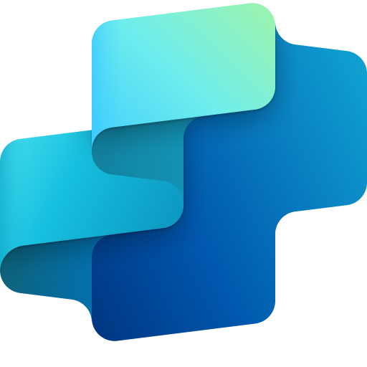
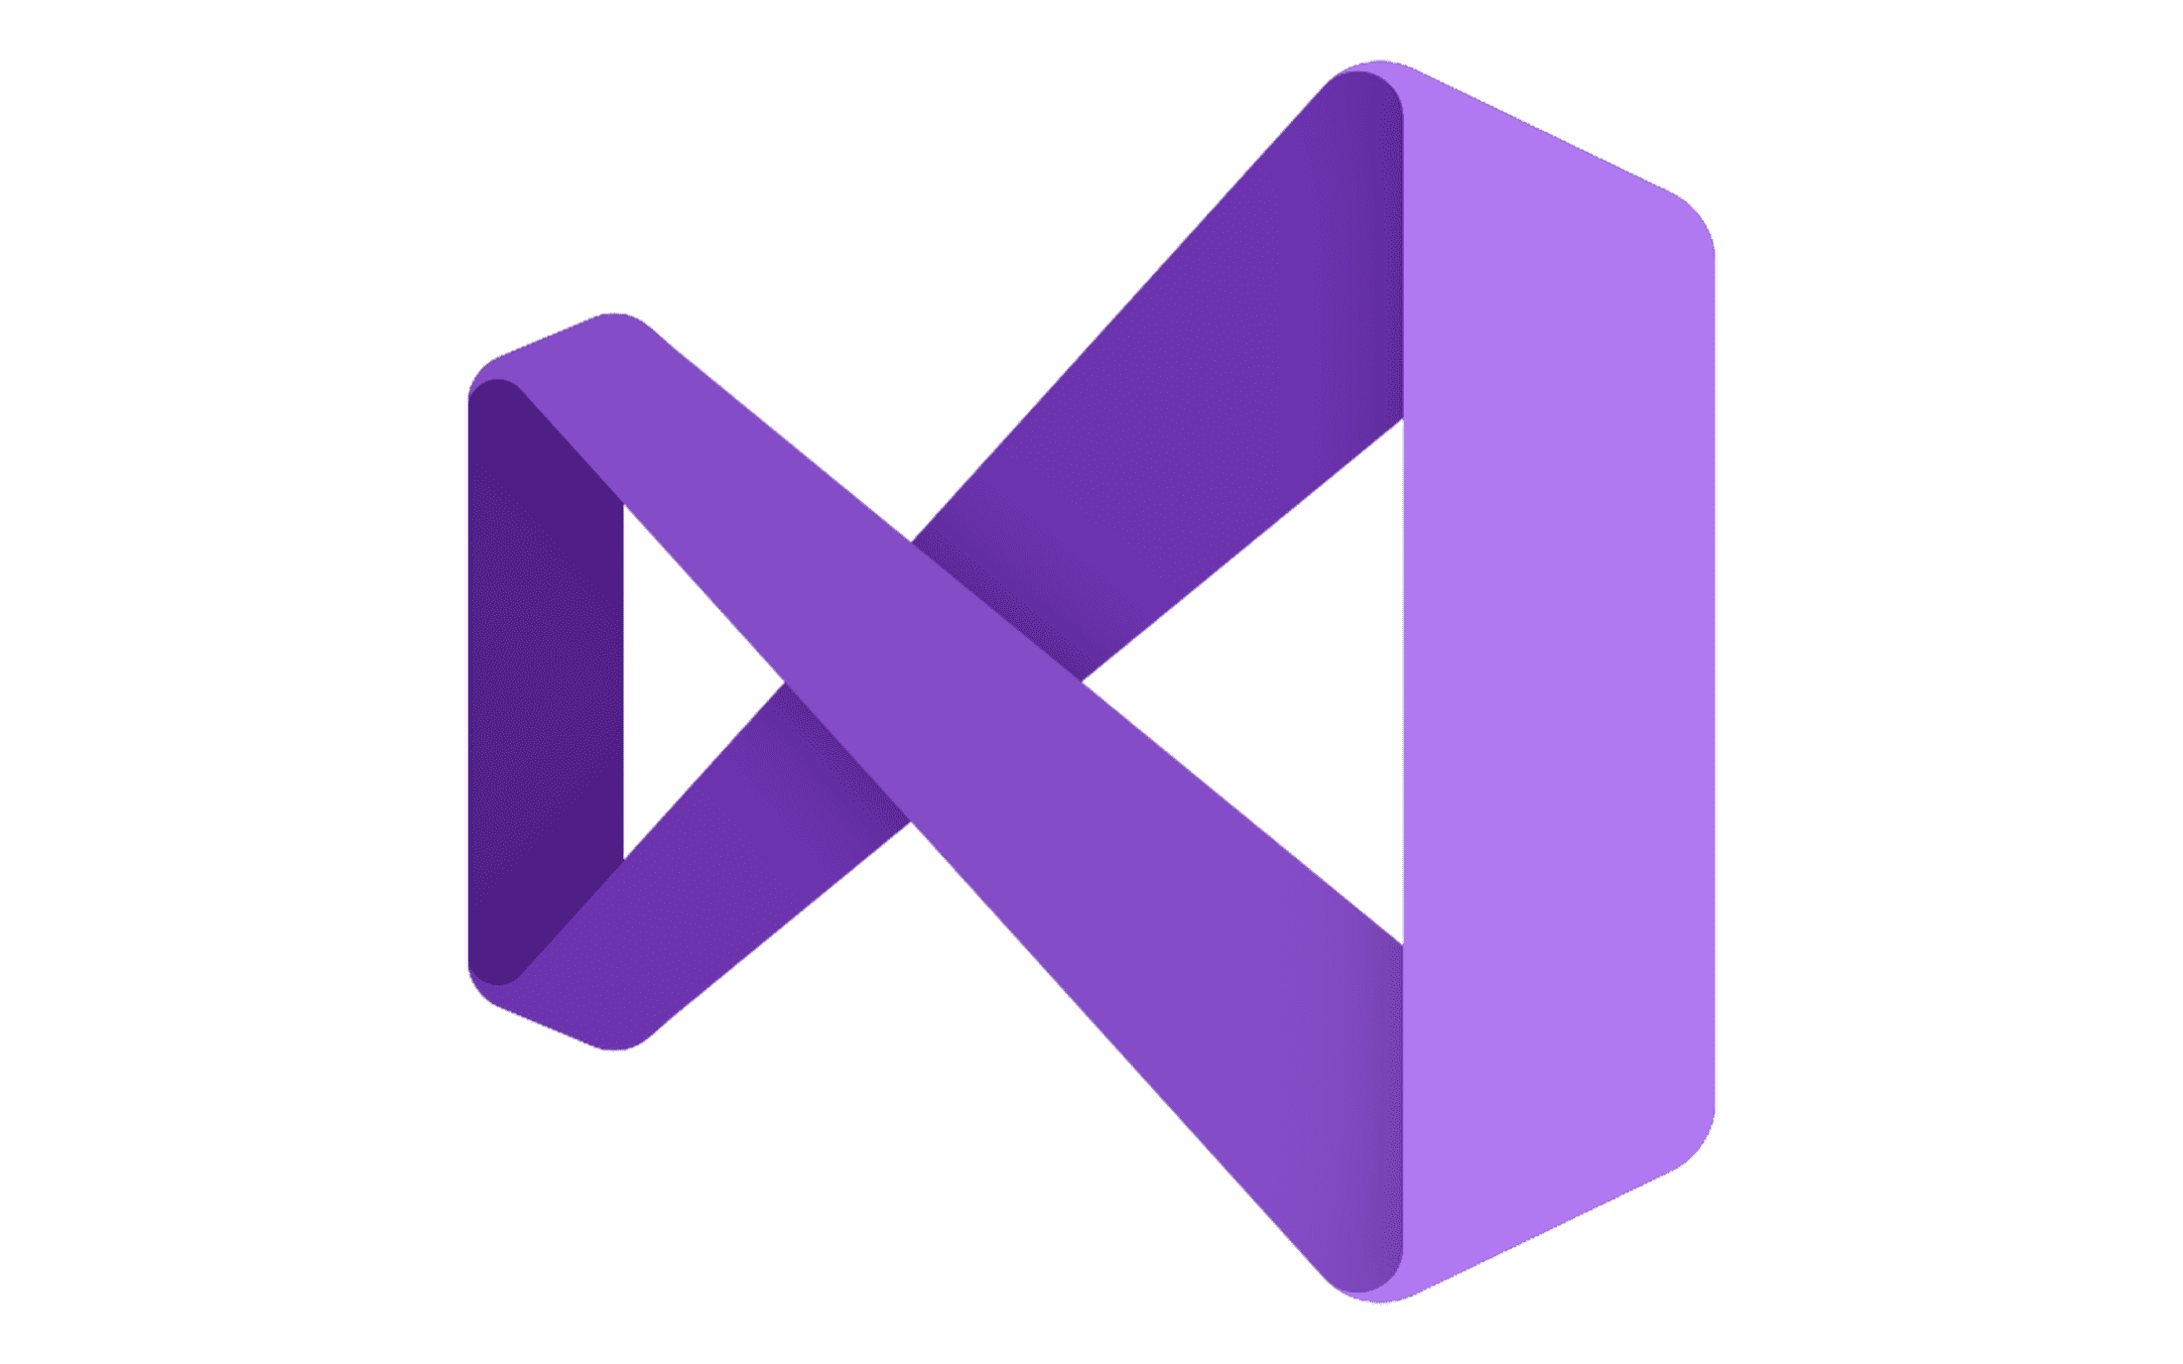

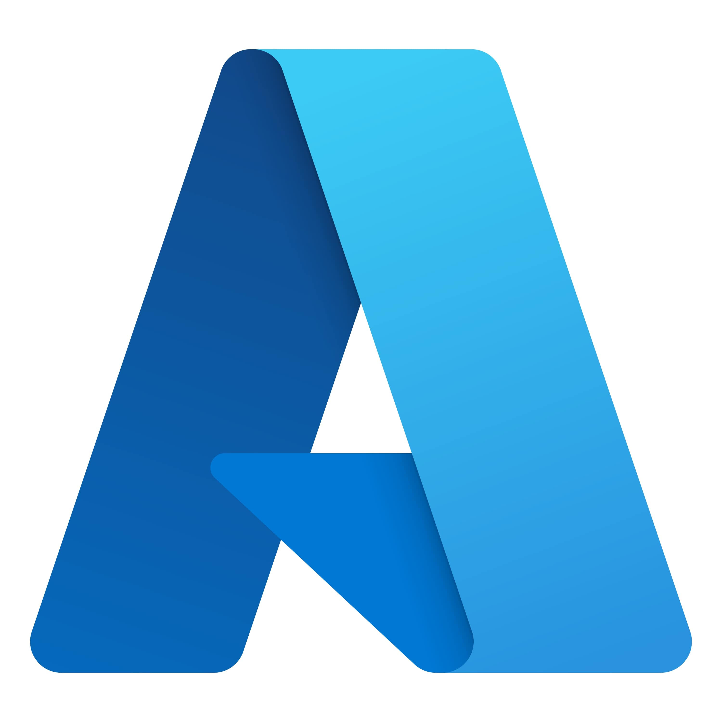
Copilot & AI stack
1a
Security
1b
Copilot
3a
Copilot devices
1b
2a
Azure AI Foundry
1
3
2
Copilot Studio
+
Your Data
Visual Studio
AI Infrastructure
+
Adaptive Cloud to Edge
GitHub
Azure
Trustworthy AI

Slide 7
Developers start small and iterate
ADVANCE PROJECT
ADVANCE PROJECT
Capacity and cost trade offs
Content Filtering
Monitoring Experimentation
Security and data privacy
Model selection
Techniques - Prompt Engineering, RAG, Fine-tuning
Evaluation
Establish feasibility
Define use cases
Pick a flagship model
Build prototypes
Get to production quality
Continually improve user experience
Prove that it works
Data
REVERT PROJECT
REVERT PROJECT
Proof of Concept
Discover & Evaluate
Development
Design & Customize
Production
Manage & Optimize

Slide 8




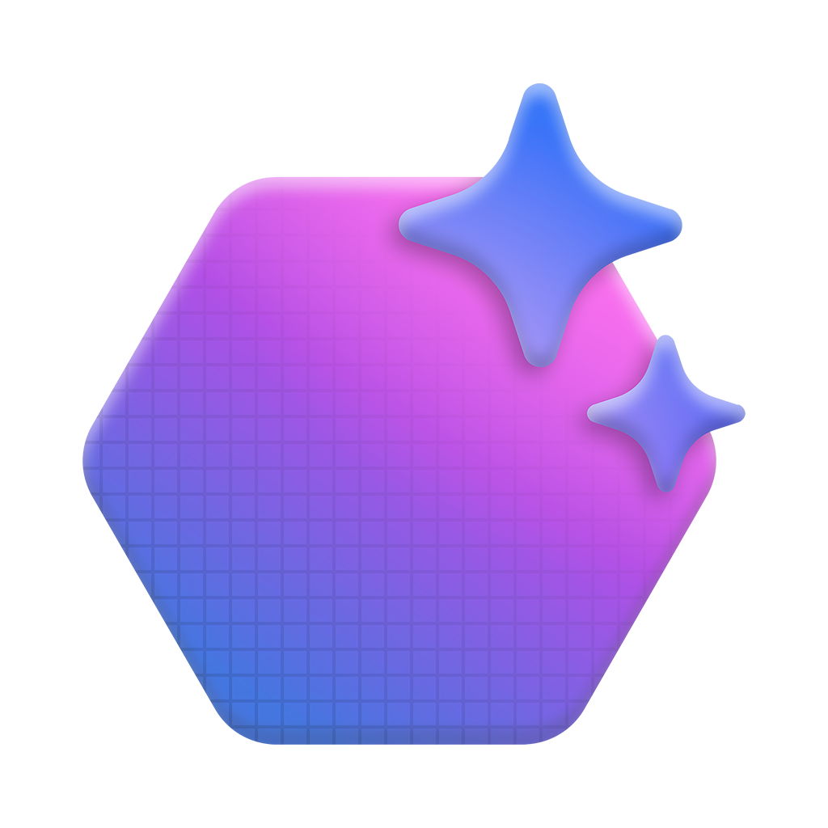

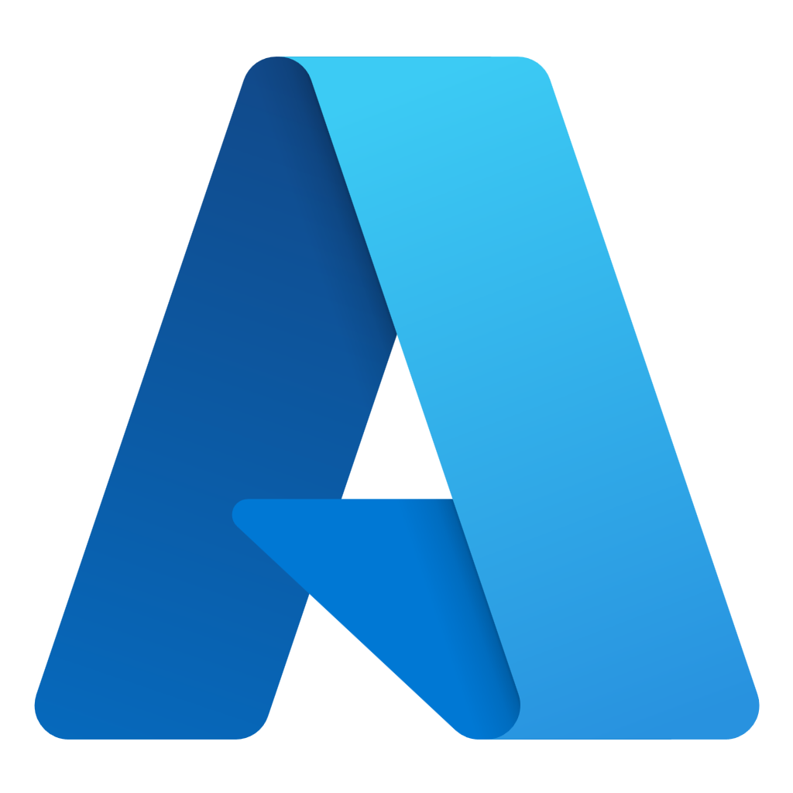
Azure AI Foundry
Model Catalog
Copilot Studio
Foundational models
Open-source models
Task models
Industry models
Visual Studio
Azure OpenAI Service
Azure AI Search
Azure AI Agent Service
Azure AI Content Safety
GitHub
Evaluations
Customization
Governance
Monitoring
Azure AI Foundry SDK
Observability

Slide 9
The paradigm shift from MLOps to GenAIOps
Traditional MLOps
GenAIOps
ML Engineers
Data Scientists
AI Engineers
App developers
Target audiences
Model, data, environments, features
LLM, agents, plugins, prompts, chains, APIs
Assets to share
Quality: accuracy, similarity Harm: bias, toxicity Correct: roundedness Cost: token per request Latency: response time, RPS
Metrics/evaluations
Accuracy, Sensitivity
ML models
Build from scratch
Pre-built, fine-tuned served as API (MaaS)

Slide 10
GenAI Lifecycle in the real world
Managing
PREPARE FOR APP DEPLOYMENT
ADVANCE PROJECT
Prompt Engineering or Fine-tuning
Find LLMs
Retrieval Augmented Generation
Quota and cost management
Safe Rollout/Staging
Hypothesis
Try prompts
BUSINESS NEED
Monitoring
Deploy LLM App/UI
Ideating/ exploring
Building/ augmenting
Tracing
Operationalizing
Evaluation
Content Filtering
REVERT PROJECT
SEND FEEDBACK

Slide 11
How do we know our results are any good?
1. Ideating/exploring
2. Building/augmenting
3. Operationalizing
Identify business use case
Run flow against sample data
Run flow against larger dataset
Deploy endpoint
Discover your model
Evaluate the flow
Evaluate the flow
Add monitoring and alerts
Test sample prompt
Modify flow (prompts and tools, etc.)
Integrate into application
Connect to your data and build LLM flows
Satisfied?
Yes
Satisfied?
Yes
No
No

Slide 12
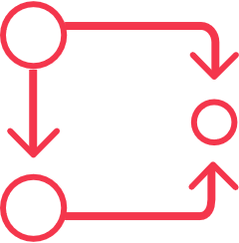
Mapping mitigations and evaluations to LLMOps
In most production applications, that includes four layers of technical mitigations:
(1) The Model (2) Safety System, (3) Meta Prompt and Grounding, and (4) User Experience Layers.
IDEATION/
EXPLORATION
Exploration Loop
Building & Augmenting Loop
Operationalizing Loop
Try Prompts
Hypothesis
Find LLMs
Safety:
Azure AI Model Catalog
Model Benchmark
Azure AI Content Safety
RAG
Prompt Engineering or Fine-Tuning
Evaluations
Exception Handling
Safety Meta prompt Components:
Harmful content
Grounding
Copyright/IP
Jailbreaks
Quota and Cost Management
Safe Rollout/Staging (A/B)
Content Filtering
Deploy LLM App/UI
Monitoring for:
Groundedness
Relevance
Coherence
Fluency
Similarity
BUILDING/
AUGMENTING
OPERATIONALIZING
Process description
The first iterative loop in LLMOps typically involves a single developer exploring and evaluating models in a model catalog to see if it’s a good fit for their use case.
It’s crucial to understand each model’s capabilities and limitations when it comes to potential harms.
The next loop, which focuses on guiding and enhancing the large language model to better meet their specific needs. (Here you add in Evalutions)
The third loop captures the transition from development to production. This loop primarily involves deployment, monitoring, and integrating with continuous integration and continuous deployment (CI/CD) processes
Notes:
https://azure.microsoft.com/en-us/blog/infuse-responsible-ai-tools-and-practices-in-your-llmops/
Customers are having trouble with mapping mitigations with tools to the steps in LLMOps
Ideating and exploring loop: Add model layer and safety system mitigations
The first iterative loop in LLMOps typically involves a single developer exploring and evaluating models in a model catalog to see if it’s a good fit for their use case. From a responsible AI perspective, it’s crucial to understand each model’s capabilities and limitations when it comes to potential harms. To investigate this, developers can read model cards provided by the model developer and work data and prompts to stress-test the model.
Safety system
For most applications, it’s not enough to rely on the safety fine-tuning built into the model itself. large language models can make mistakes and are susceptible to attacks like jailbreaks. In many applications at Microsoft, we use another AI-based safety system, Azure AI Content Safety, to provide an independent layer of protection to block the output of harmful content. Customers like South Australia’s Department of Education and Shell are demonstrating how Azure AI Content Safety helps protect users from the classroom to the chatroom.
Building and augmenting loop: Add metaprompt and grounding mitigations
Once a developer identifies and evaluates the core capabilities of their preferred large language model, they advance to the next loop, which focuses on guiding and enhancing the large language model to better meet their specific needs. This is where organizations can differentiate their applications.
Metaprompt and grounding
Proper grounding and metaprompt design are crucial for every generative AI application. Retrieval augmented generation (RAG), or the process of grounding your model on relevant context, can significantly improve overall accuracy and relevance of model outputs. With Azure AI Studio, you can quickly and securely ground models on your structured, unstructured, and real-time data, including data within Microsoft Fabric.
Evaluate your mitigations
It’s not enough to adopt the best practice mitigations. To know that they are working effectively for your application, you will need to test them before deploying an application in production. Prompt flow offers a comprehensive evaluation experience, where developers can use pre-built or custom evaluation flows to assess their applications using performance metrics like accuracy as well as safety metrics like groundedness. A developer can even build and compare different variations of their metaprompts to assess which may result in the higher quality outputs aligned to their business goals and responsible AI principles.
Operationalizing loop: Add monitoring and UX design mitigations
The third loop captures the transition from development to production. This loop primarily involves deployment, monitoring, and integrating with continuous integration and continuous deployment (CI/CD) processes. It also requires collaboration with the user experience (UX) design team to help ensure human-AI interactions are safe and responsible.

Slide 13
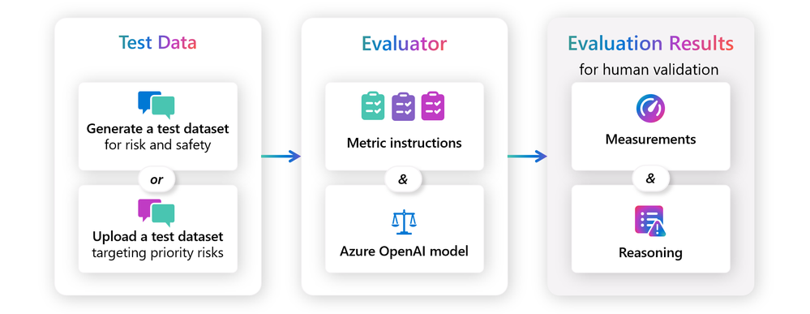
Evaluators
Notes:
Evaluators are immutable prompt flow assets that contain evaluation metrics, parameters, and an Azure OpenAI model deployment to perform the assessment. Microsoft provides pre-built evaluators for specific quality and safety metrics and customers can also create their own evaluators that contain their preferred metrics and parameters.
Evaluators can be customized, versioned, and shared across an organization for improved consistency across projects. Developers can run evaluators locally and log results in the cloud using the prompt flow SDK or run them as part of an automated evaluation within the Azure AI Studio UI.
Create an evaluator
You can create code-based and prompt-based evaluators:
Code-based evaluators offer flexibility to define metrics based on functions or callable classes without requiring a large language model, as seen in as seen in examples like answer_length.py.
Prompt-based evaluators enable the creation of custom evaluators using prompty files, which contain YAML-formatted metadata defining model configuration and expected inputs, as illustrated by the example apology.prompty file.

Slide 14
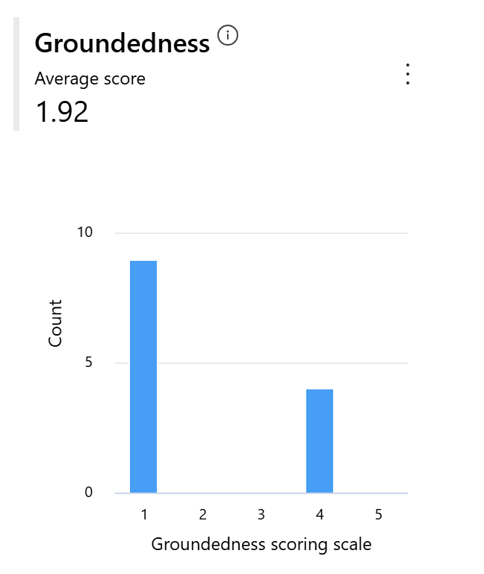
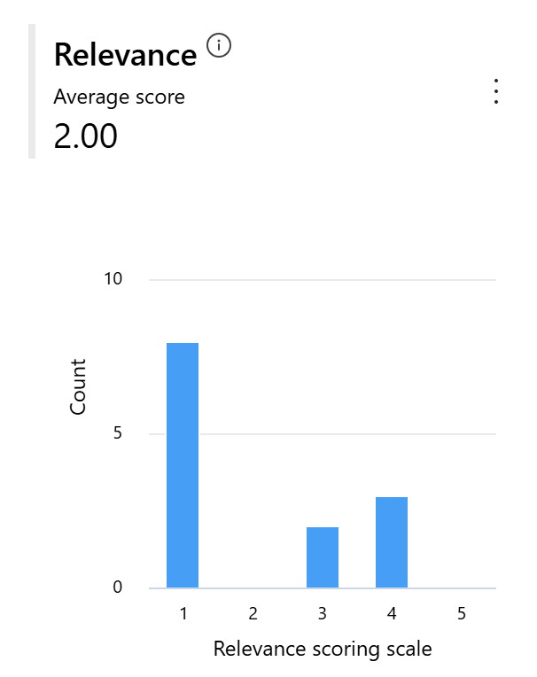
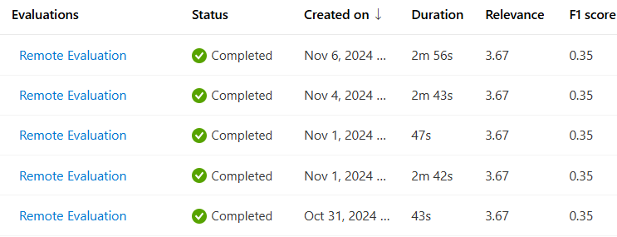
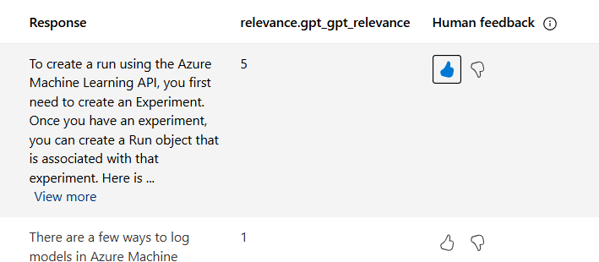
Evaluations
Demo
Evaluate outputs of application during local development
Batch runs in the cloud for large data sets
Drill into results and add human feedback

Slide 15

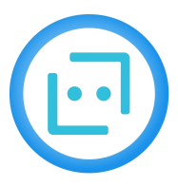



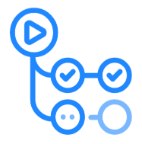
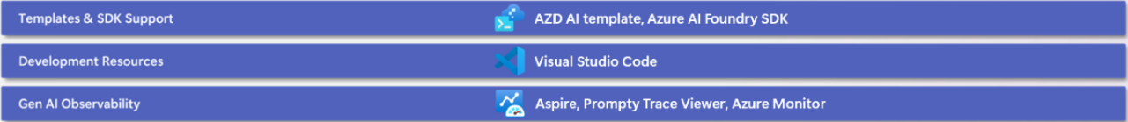
Robust GenAIOps Toolchains in Azure AI
Bringing your AI apps to production
Resource Set-up
Playground
RAG
Fine-tuning
Prompt Management
Evaluation / Debugging
Orchestration
Automation
Monitoring
AZD AI Template
Chat Playground
Azure AI Search
Microsoft Fabric
Serverless Fine-tuning
Azure AI Agents
Prompty
Azure AI Foundry
Tracing
Azure AI Content Safety
Evaluators
Prompt flow
LangChain
Semantic Kernel
GitHub
Actions
Azure Monitor
Application Insights

Slide 16
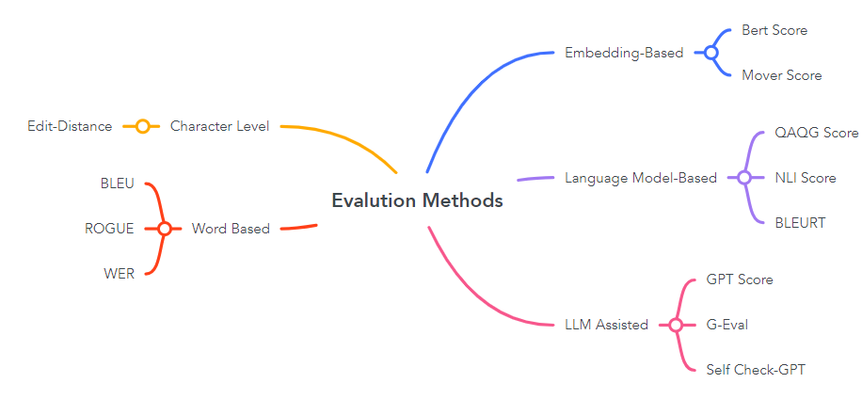
Pushing the limits of Evaluations

Slide 17
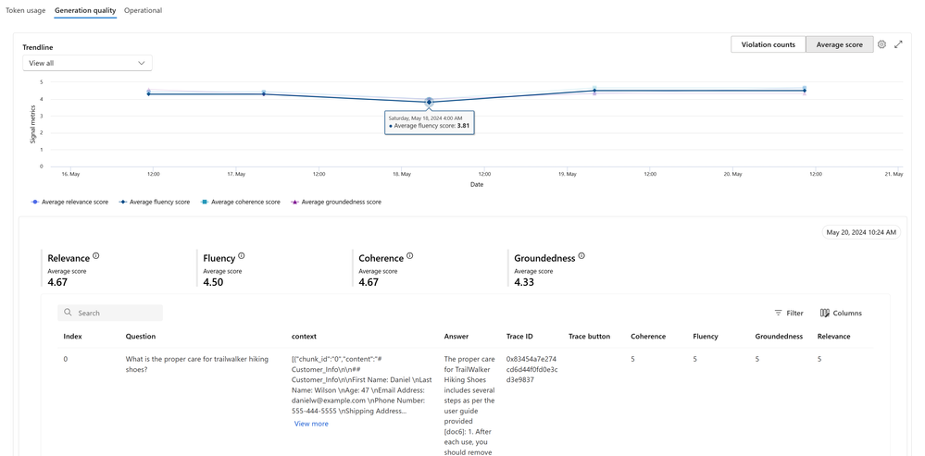
Notes:
https://techcommunity.microsoft.com/t5/ai-ai-platform-blog/new-generative-ai-app-evaluation-and-monitoring-capabilities-in/ba-p/4146882
With this information, your organization can make proactive improvements to deployed applications based on fresh signals. Capabilities of Azure AI Studio monitoring include:
Apply generation quality such as groundedness, coherence, fluency, and relevance, which are interoperable with prompt flow evaluation metrics.
Monitor prompt, completion, and total token usage across each model deployment in your prompt flow.
Monitor operational metrics, such as request count, latency, and error rate.
Enable continuous alerting and metric computations for nonstop observability.
Consume data visualizations and per-request tracing data in Azure AI Studio.

Slide 18
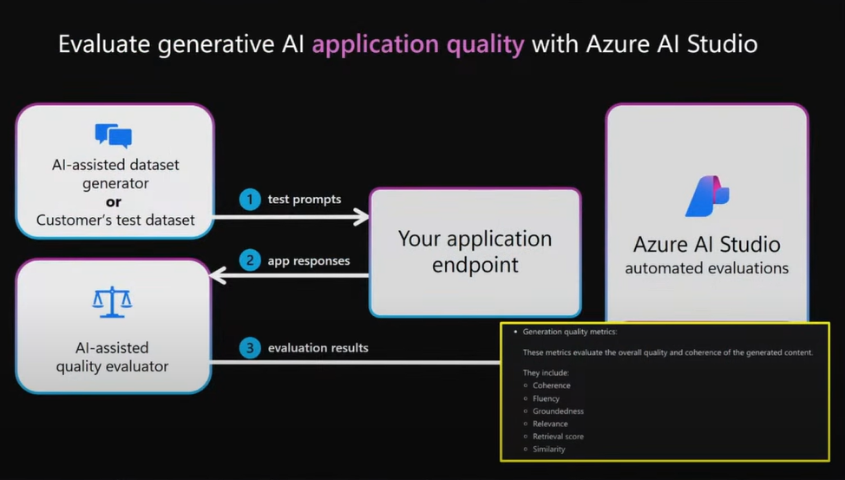
Notes:
https://reactor.microsoft.com/en-us/reactor/events/23334/ minute 39

Slide 19
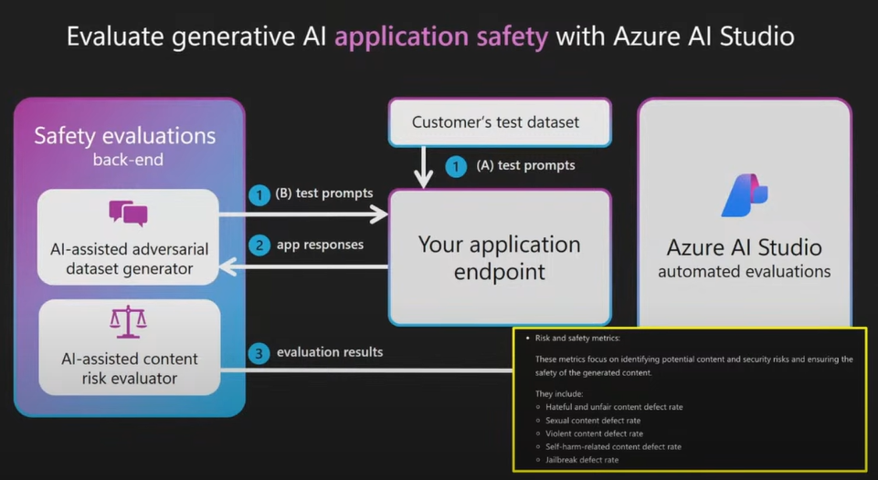

Slide 20
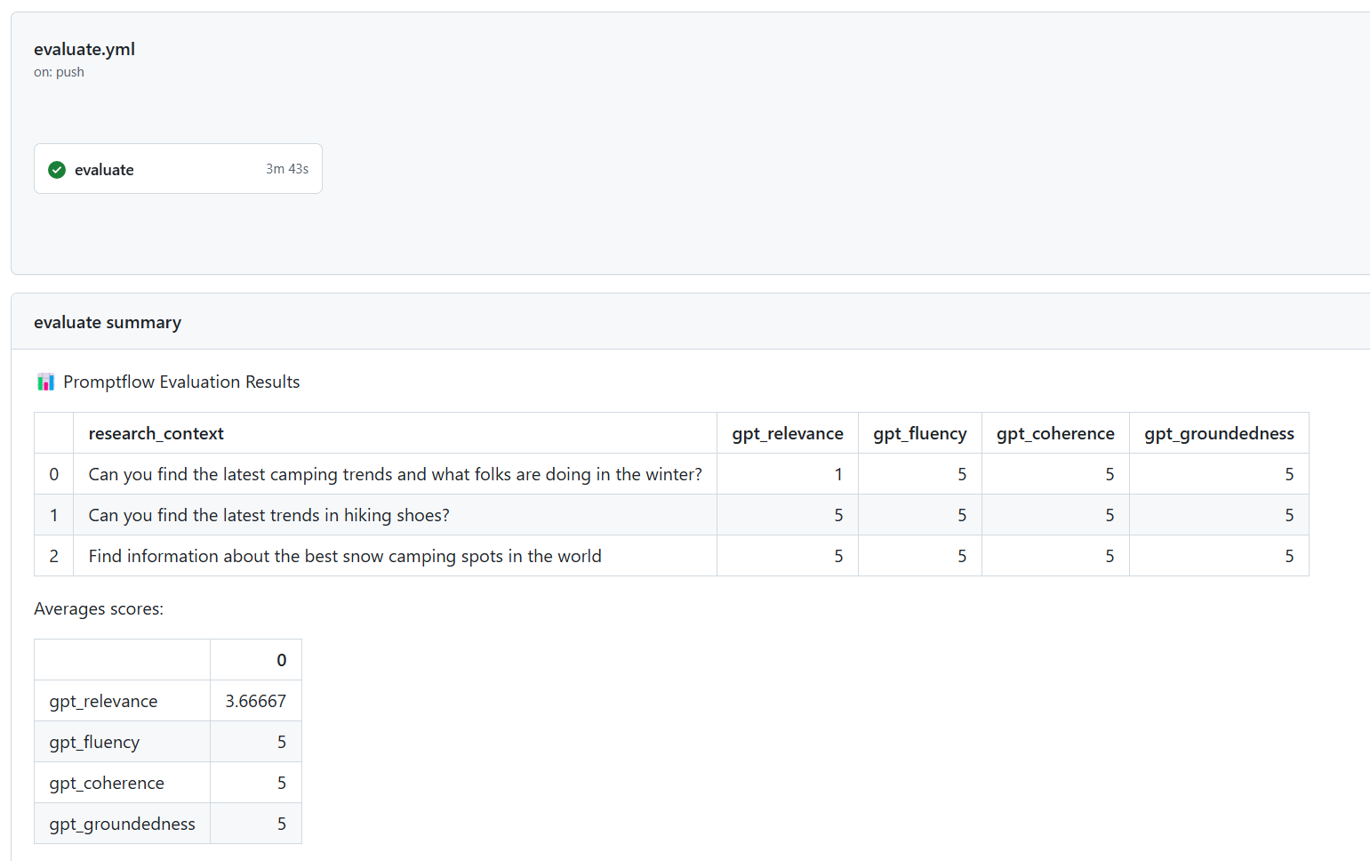
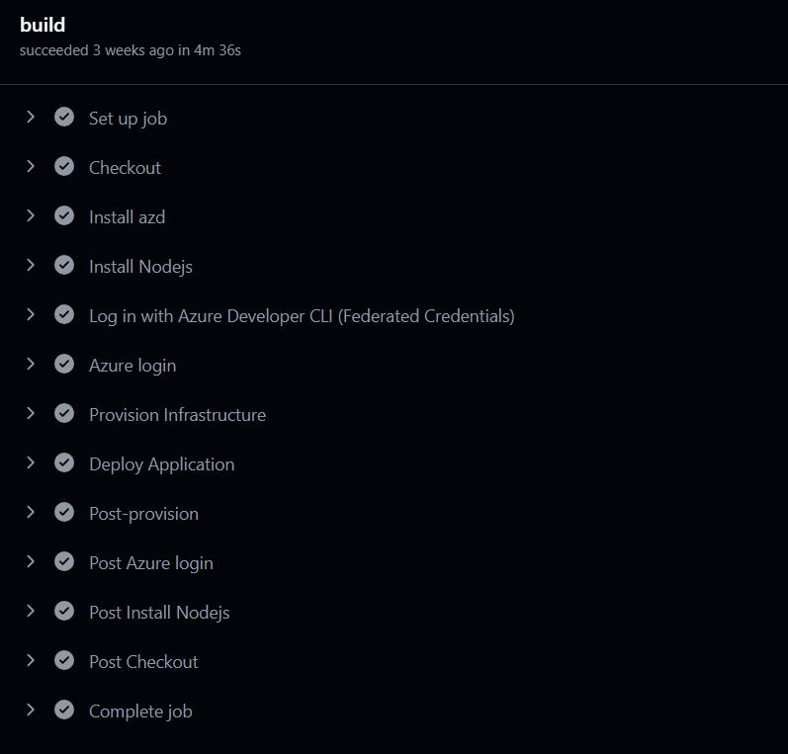
Evaluations in GitHub actions
Demo
AZD to configure GitHub actions to evaluate and deploy

Slide 21

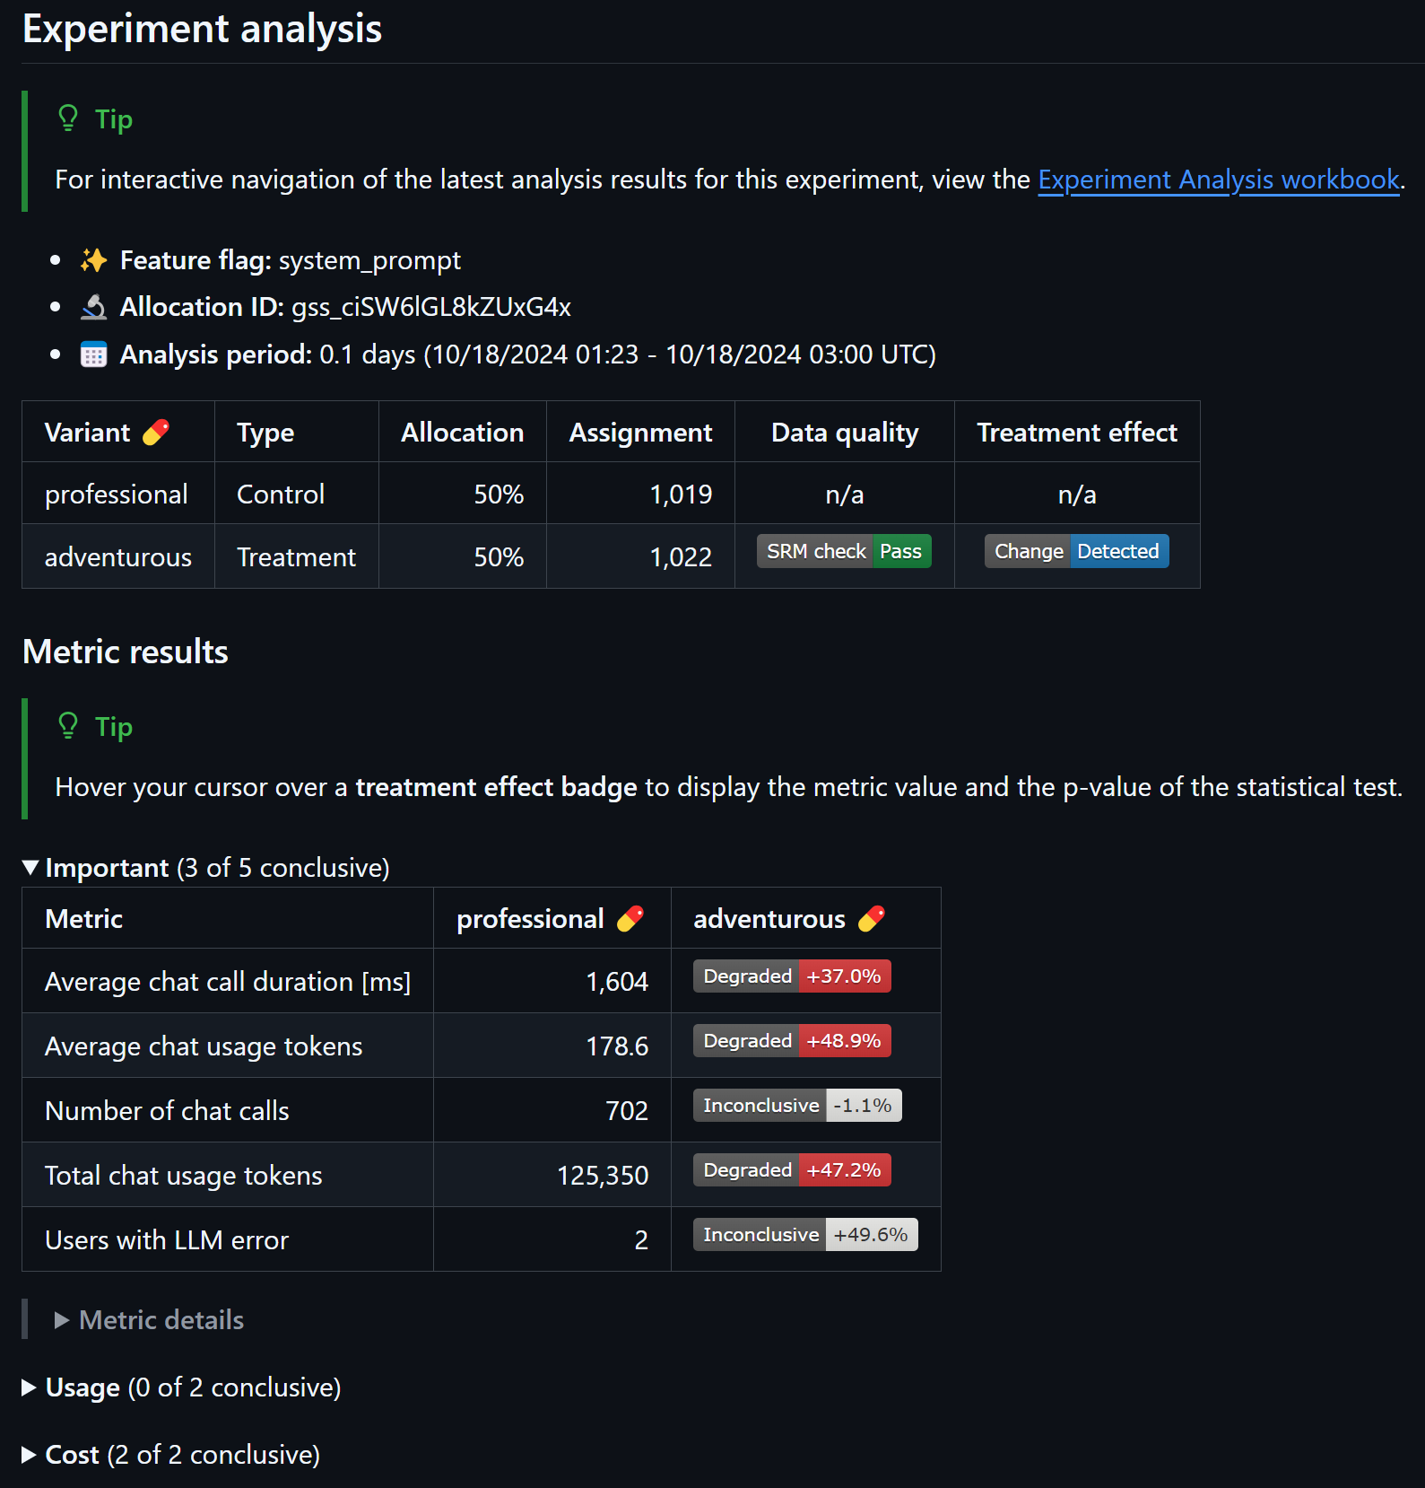
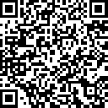
Azure AI Evaluation and Experimentation
Scale AI applications using CI/CD workflows
Streamline workflows with GitHub Actions for evaluation and A/B experimentation
Evaluate full impact with out-of-the-box AI model metrics and custom metrics
GitHub Copilot for Azure plugin that assists with experimentation, creates metrics, powers decisions, and more
Sign up for the private preview: aka.ms/genAI-CI-CD-private-preview

Slide 22
What slows down Generative AI adoption?
Getting Started | The state of the art is evolving so quickly, it makes it difficult to decide what to use. Along with that, guidance and documentation is hard to find.
Development | Applications often require multiple cutting-edge products and frameworks which requires specialized expertise and new tools to stitch these components together.
Context | Large Language Model doesn't know about your data
Evaluation | It is hard to figure out which model to use and how to optimize for their use case.
Operationalization | Concerns around privacy, security, and grounding. Developers lack the experience and tools to evaluate, improve and validate the solutions for their Proof of Concepts, and to scale and operate in production.

